Slide 1
Inventory Management System On Educational Provisions
BHAVANI – 231003003 (team lead)
HASMITHA-2310030103
ANANDA KRISHNA – 2310030427
SUMEAIRA - 2310030186

Slide 2
Features:
Real-time tracking of educational resources (textbooks, lab equipment, digital devices)
Automated alerts for low stocks .
Integration with existing campus management systems (SIS, ERP)
Customizable applications tailored to higher education needs
Secure management of valuable assets and controlled substances

Slide 3
Project Feasibility Analysis
Technical Feasibility:
Availability of advanced software solutions for real-time tracking and automated alerts.
Capability to integrate with existing campus management systems.
Financial Feasibility:
Potential cost savings through reduced waste and prevention of stockouts.
Initial investment required for software, hardware, and training.
Operational Feasibility:
Increased efficiency in inventory management processes.
Enhanced educational outcomes through timely access to necessary resources.

Slide 4
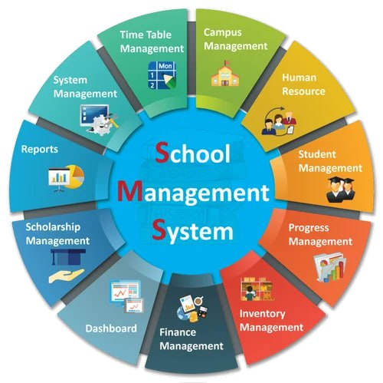

Slide 5
Analysis
Organization
Faculties
Students
Advanced software solutions available for real-time tracking and automated alerts.
Potential cost savings by reducing waste and preventing stockouts.
Enhanced resource availability for students and staff

Slide 6
Oriented with Societal Needs
Societal Impact:
Enhances Accessibility: Ensures that all students and staff have timely access to necessary educational resources, leveling the playing field.
Economic Benefits: Prevents overstocking and understocking, which can lead to significant cost savings for the institution, allowing funds to be allocated to other important areas such as scholarships and research.
Community Engagement: By ensuring efficient use of resources, the institution can donate surplus equipment to local schools or community organizations, fostering a sense of community and social responsibility.

Slide 7
Novelty of the Project
Advanced Technologies: Utilizes cutting-edge technologies such as RFID (Radio Frequency Identification) and AI (Artificial Intelligence) for precise end-to-end tracking and management of inventory.
Leverages IoT (Internet of Things) devices to provide real-time data and analytics.
Comprehensive Solutions: Offers a unified platform that efficiently manages both frequently used items like classroom supplies and high-value assets such as laboratory equipment.
Educational Focus: Addresses the unique needs of essential equipment, such as projectors, lab instruments, and IT resources, ensuring they are readily available and well-maintained.
Sustainability and Cost Efficiency: Helps the institution achieve significant cost savings by preventing overstocking and understocking scenarios.

Slide 8
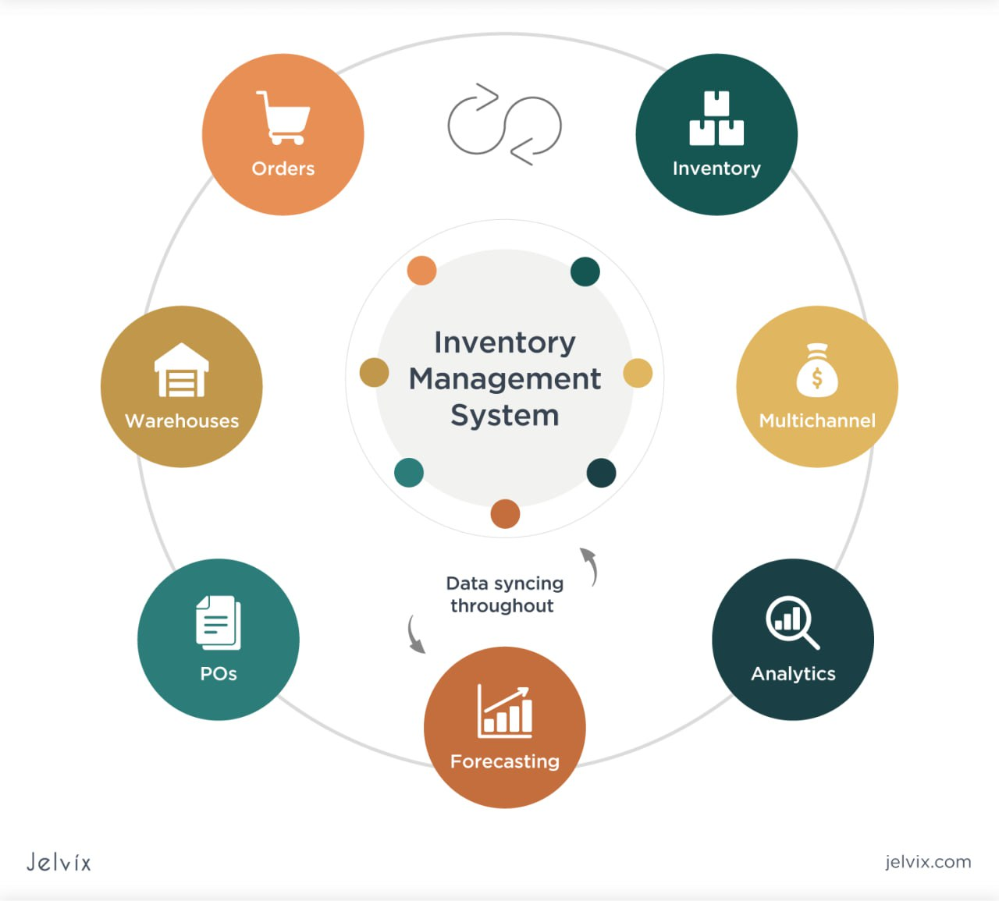
Implementation Plan
Steps:
Establish Clear Objectives
Conduct a Needs Assessment
Budget Allocation
Vendor Selection
System Customization
Data Migration
Pilot Testing
Develop Standard Operating Procedures
Communication Plan to inform all stake holders
Feedback Collection from the staff
Regular Training Refreshers
Performance Metrics
Continuous monitoring of Improvement
Scalability Planning
Compliance and Security

Slide 9
Core Components:
Class Diagrams: Visualize classes, attributes, methods, and their relationships (inheritance, aggregation).
Object Diagrams: Show instances of classes and their relationships at a specific time.
Use Case Diagrams: Illustrate interactions between users and the system, defining expected functionality.
Sequence Diagrams: Depict chronological interactions between objects, showing message sequences.
Implementation Steps:
Class Creation: Translate class diagrams into code; define attributes and methods.
Object Instantiation: Create instances of classes and assign attribute values.
Method Calls: Invoke methods on objects, handle return values.
Relationship Implementation: Implement relationships (inheritance, aggregation) between objects.
Testing: Write unit tests for methods and classes, and conduct integration tests
Key Considerations:
Code Reusability: Design reusable classes and methods.
Maintainability: Write clean, well-documented code.
Efficiency: Optimize for performance.
Error Handling: Implement robust error handling mechanisms

Slide 10
Implementation Phases
Phase 1: Requirements Gathering & Analysis:
Conduct thorough needs assessments with stakeholders (e.g., administrators, teachers, staff).
Analyze existing inventory management processes and identify pain points.
Define system requirements (functional and non-functional).
Phase 2: Design & Development:
Design the system architecture (e.g., database design, user interface).
Develop the software application (e.g., using a suitable programming language and framework).
Conduct unit testing and integration testing.
Phase 3: Data Migration & Integration:
Migrate existing inventory data into the new system.
Integrate the system with other relevant systems (e.g., accounting software, ERP).
Phase 4: User Training & Support:
Develop user manuals and training materials.
Conduct user training sessions.
Provide ongoing technical support and maintenance.
Phase 5: Go-Live & Monitoring:
Go-live with the new system.
Monitor system performance and user feedback.
Make necessary adjustments and improvements.

Slide 11
Expected Outcomes
.
Reduced Waste and Cost Savings:
Efficiently managing resources reduces waste, leading to significant cost savings for the institution
Improved Student Care and Safety:
Ensuring the timely availability of educational materials and resources enhances the learning experience
and safety of students.
Enhanced Operational Efficiency:
Streamlining inventory processes allows staff to focus on core educational activities, improving overall
efficiency.
Compliance with Regulatory Standards:
Adhering to regulatory requirements ensures the institution meets legal standards and maintains
high quality and safety.

Slide 12
Conclusion
An efficient inventory management system is crucial for educational institutions to ensure optimal resource allocation and operational success. Implementing advanced technologies can significantly improve inventory management practices, leading to enhanced student experiences and overall institutional effectiveness.
This change will allow educational institutions to thrive by making the most out of their resources, ensuring students and staff have everything they need when they need it, and ultimately contributing to a more effective and engaging learning environment.

